Slide 1
What is Sound?

Slide 2
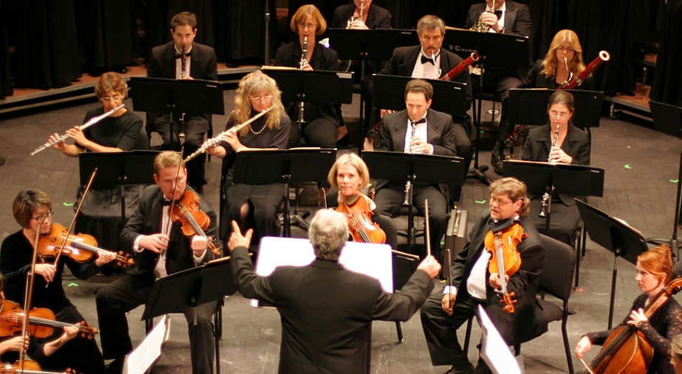
sound: a form of energy that travels through the air

Slide 3
vibration: a back-and-forth movement of matter

Slide 4
volume: the loudness of a sound

Slide 5
pitch: how high or how low a sound is

Slide 6
frequency: the number of vibrations per second

Slide 7
Shorter or tighter strings have a higher frequency (and a higher pitch)
Longer or looser strings have a lower frequency (and a lower pitch)

Slide 8
When a sound wave strikes a surface, three things can happen…
Reflection-a wave bounces off of a surface (echo)
Transmission-a wave passes through a material
Absorption-a wave passes into a material and dies out

Slide 9
Vocal chords produce vibrations, sound waves move through the air, finally vibrations move the ear drum.

Slide 10
Sound waves travel faster through liquids and even faster through solids.

Slide 11
Just how loud would an exploding Death Star be?

Slide 12
Many animals can hear sounds that are outside the range of human hearing.

Slide 13
Echolocation

Slide 14
Many animals sense vibrations with more than just their ears.

