Slide 1
What is Light?

Slide 2
Light is what allows us to take pictures.

Slide 3
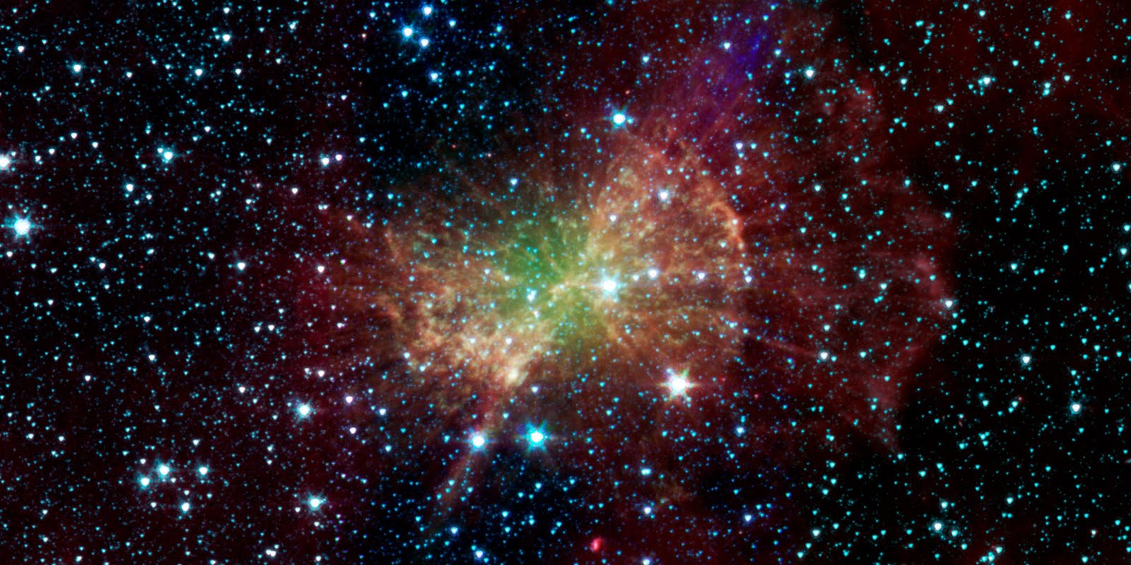
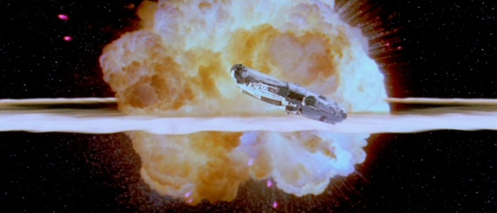
Light and sound are both energy that travel as waves, but only one is found in space.
Light
Sound

Slide 4
Visible light is only a small part of all light.

Slide 5
Not all animals see the same colors.

Slide 6
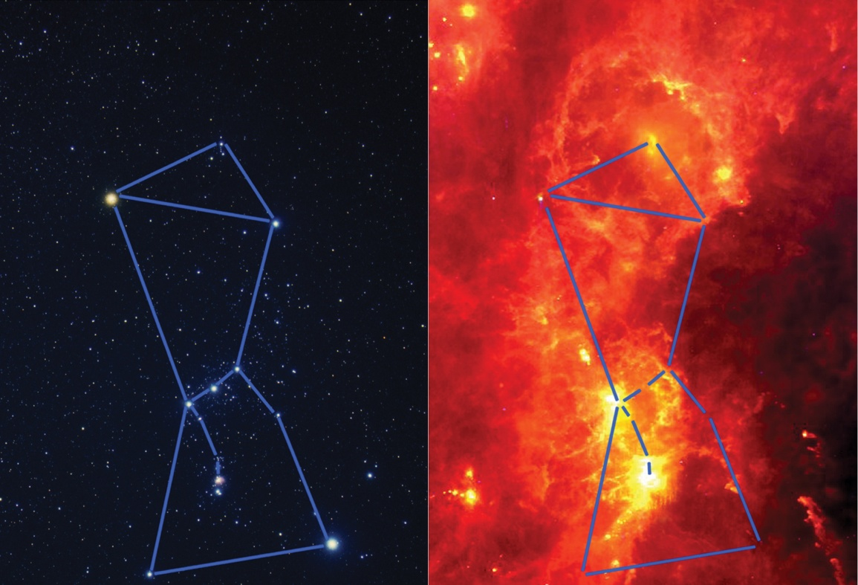
Infrared

Slide 7
Visible light

Slide 8
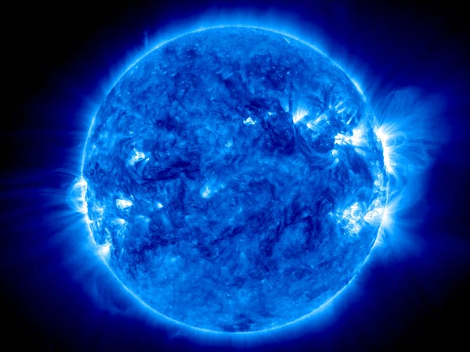
Ultraviolet

Slide 9
X-ray

Slide 10
Gamma rays

Slide 11
Sound waves are compression waves (a) Light waves are transverse waves (b)

Slide 12
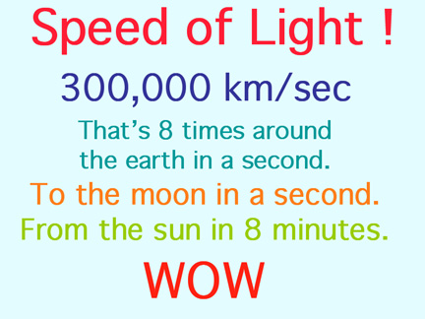
And you thought sound was fast!

Slide 13
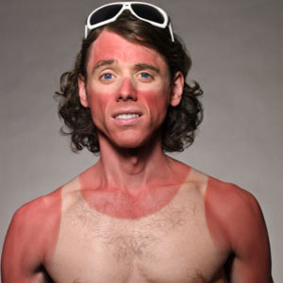
You feel the energy in light when you stand out in sunlight.

Slide 14
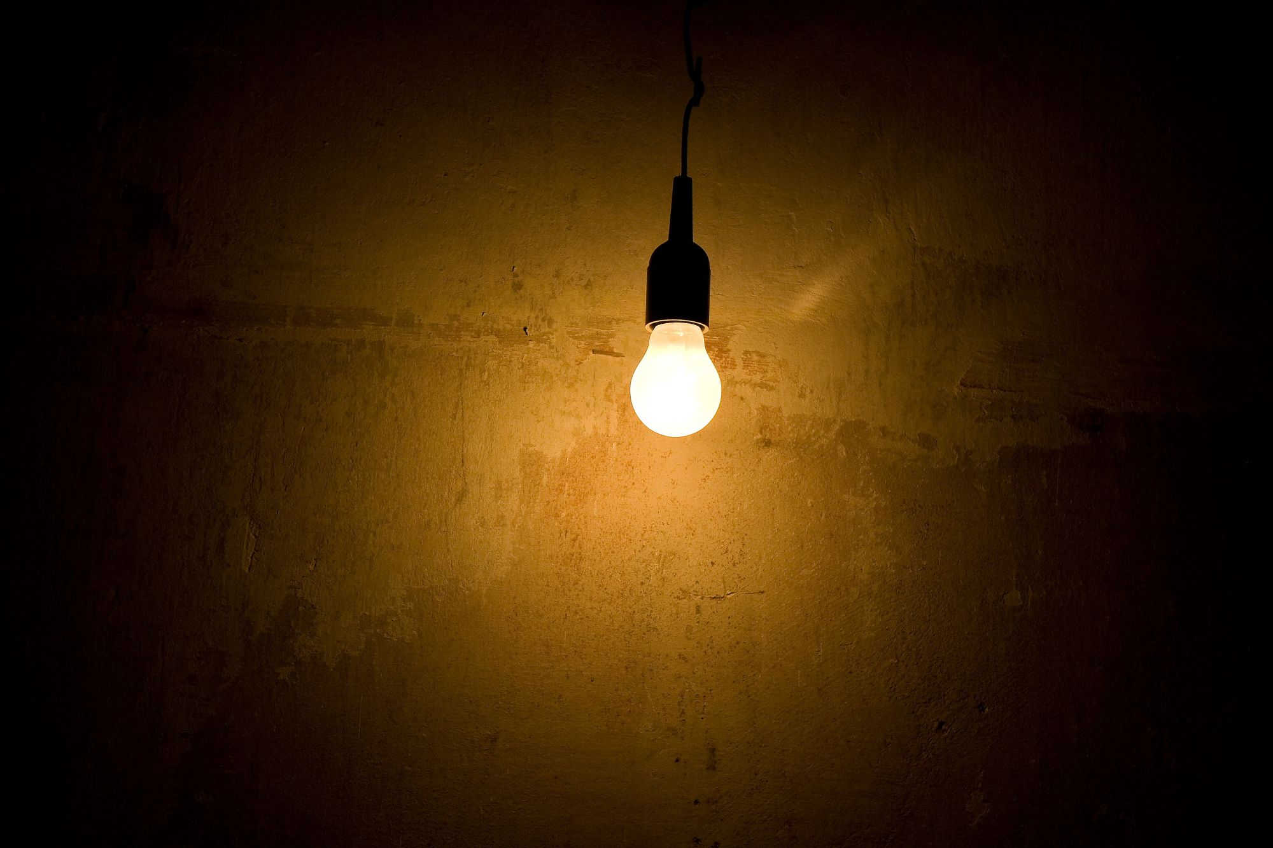
Heat from a light bulb comes from a burning filament.

Slide 15
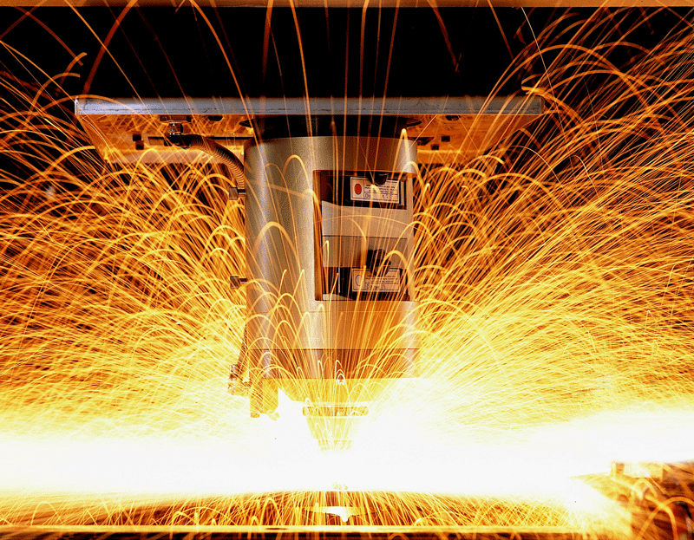
A laser gives off light in a narrow beam.

Slide 16
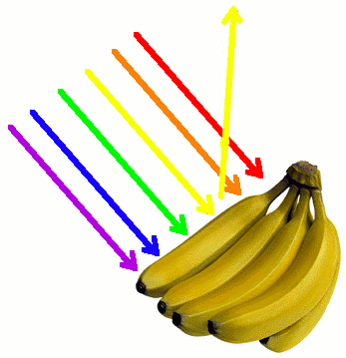
Some light energy is absorbed and some is reflected.

Slide 17
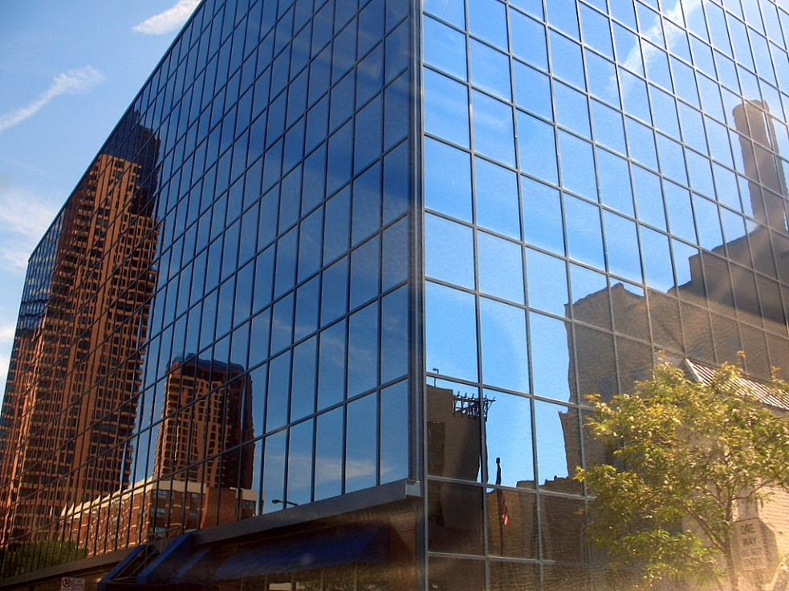
A smooth surface reflects light in a predictable pattern.

Slide 18
Light reflects off a smooth surface at the same angle in which it contacted the surface.

Slide 19
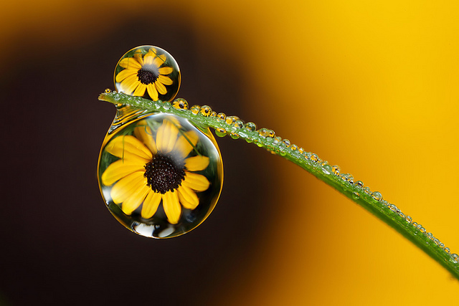
refraction: the bending of light rays

Slide 20
Transparent-Translucent-Opaque

Slide 21
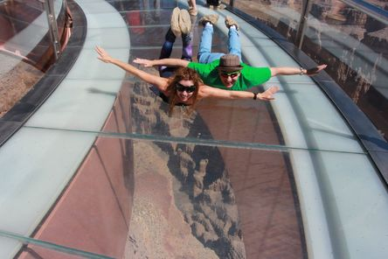
Transparent

Slide 22
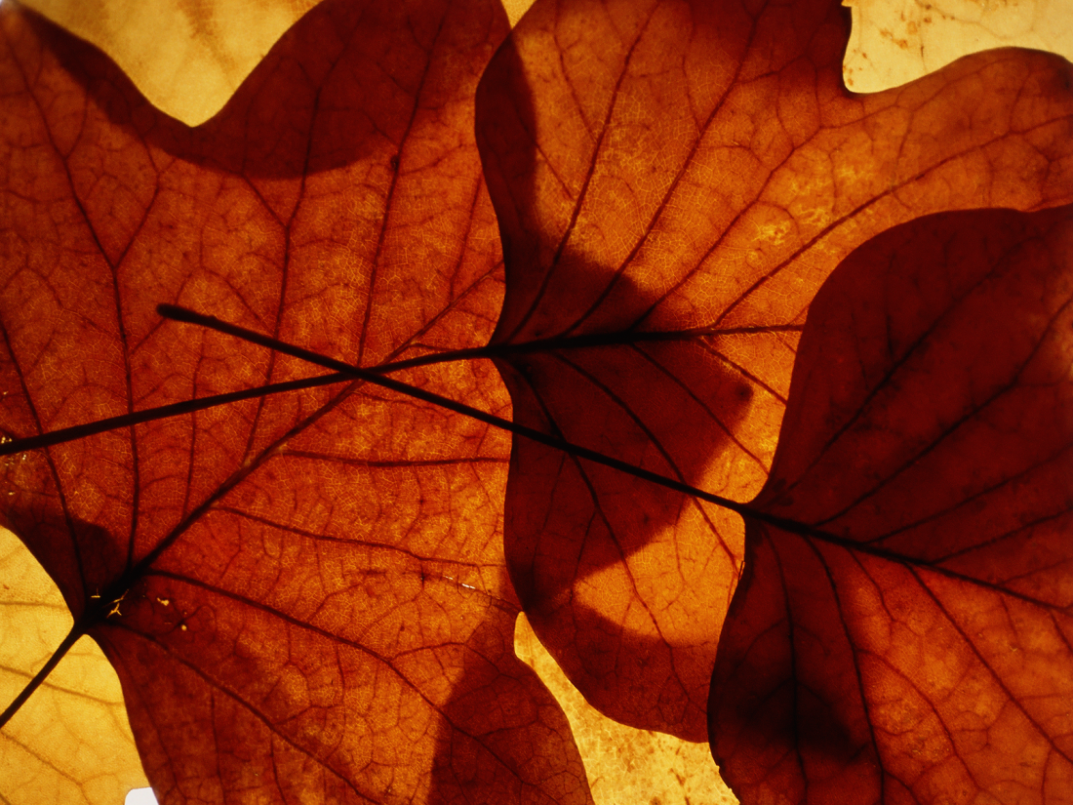
Translucent

Slide 23
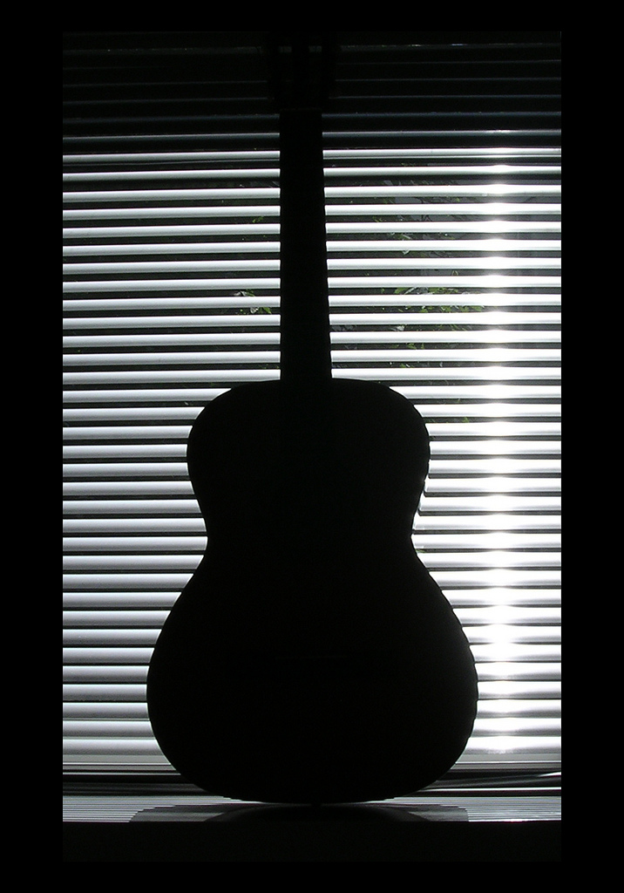
Opaque

