Slide 1
What is an Ecosystem?

Slide 2
Where do you live?
Small town (rural)
Big city (urban)

Slide 3
ecosystem
All the living and nonliving things in an area

Slide 4
An ecosystem can be very small.

Slide 5
An ecosystem can also be large.

Slide 6
What makes up the Blue Ridge mountains ecosystem?
Living
Nonliving

Slide 7
population
A group of the same kind of living things in an ecosystem

Slide 8
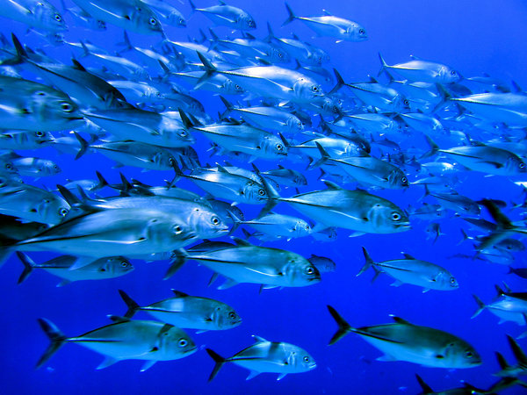
These are populations.

Slide 9
Why is this not an example of a population?

Slide 10
Why is this animal endangered?

Slide 11
Why is this animal endangered?
This insect can only live in one kind of ecosystem.
If something happens to that ecosystem…
…the insect may not survive.

Slide 12
Mangrove swamp

Slide 13
The Okefenokee Swamp

Slide 14
The Okefenokee Swamp

Slide 15
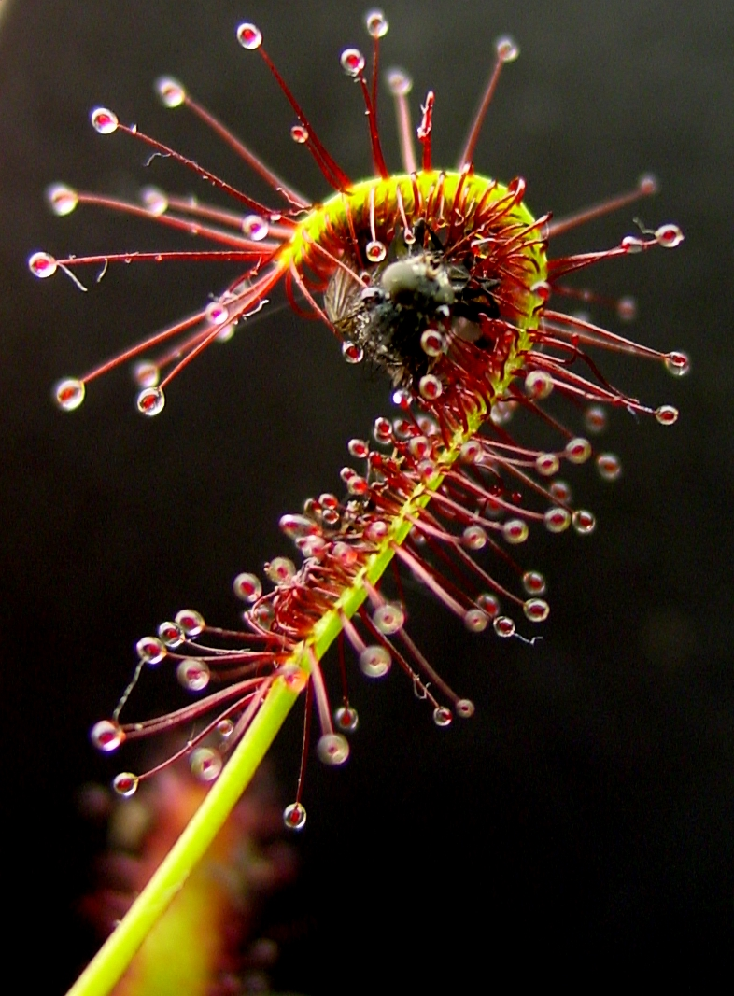
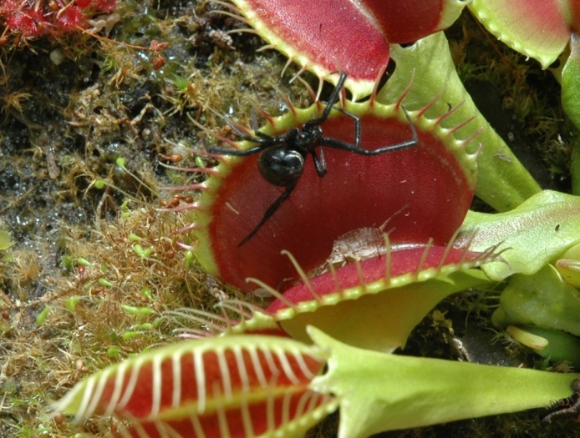
Carnivorous Plants

Slide 16
The populations of living things in coastal communities are different from those found in the swamps.

