Slide 1
What Are Inquiry Tools?

Slide 2
Non-standard units of measure
Cubit
Hand
Foot
Pace
Why might these measurements lead to confusion and arguments?

Slide 3
Volume of a rectangular solid

Slide 4
microscope
A tool that makes objects look larger

Slide 5
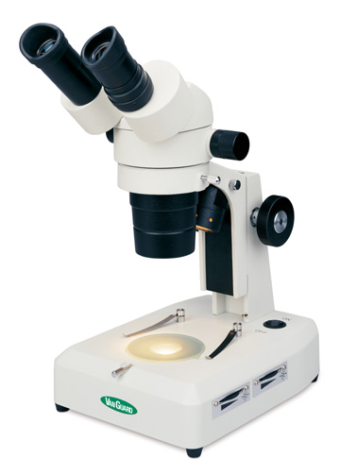
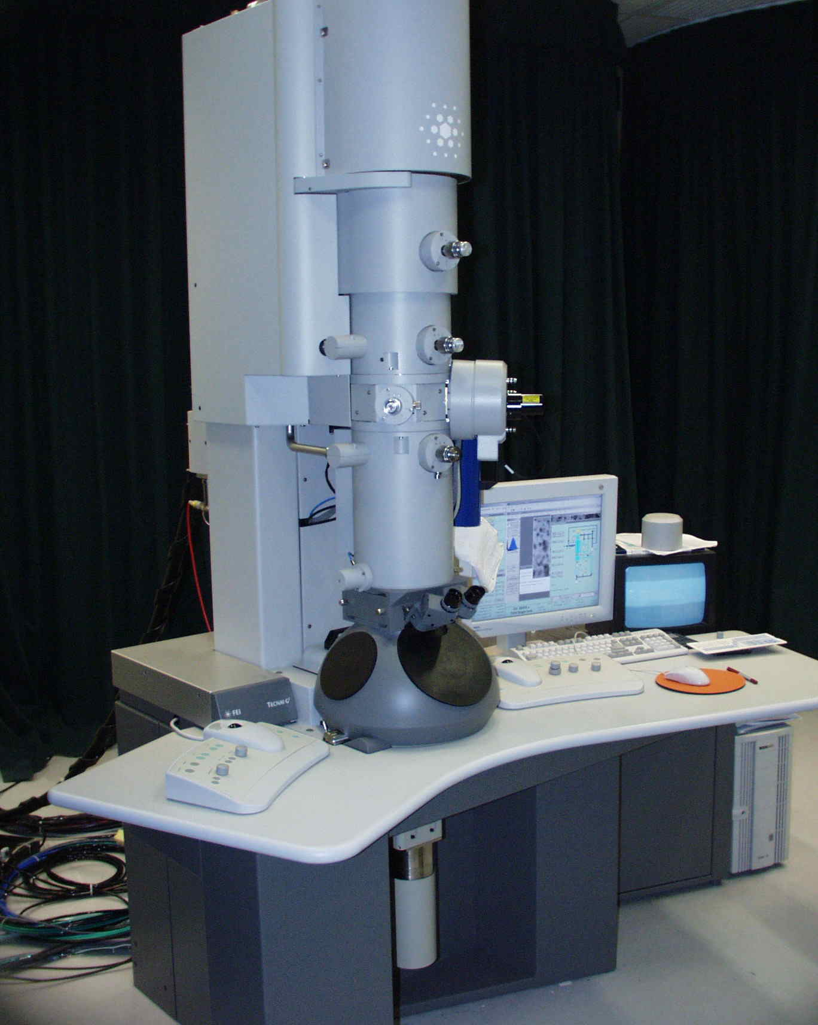
Kinds of Microscopes
Stereo
Transmission Electron
Compound Light

Slide 6
Pan Balance
Measures the mass of an object.
Mass is how much space an object takes up.
Unit: grams (g)

Slide 7
Spring Scale
Measures forces such as gravity and the effects of those forces on objects.
Weight is the effect gravity has on an object.
Unit: Newtons (N)

Slide 8
On Earth this astronaut weighs 240 lb.
Weighs zero pounds
Weighs 60 pounds

