Slide 1
What Are Inquiry Skills?

Slide 2
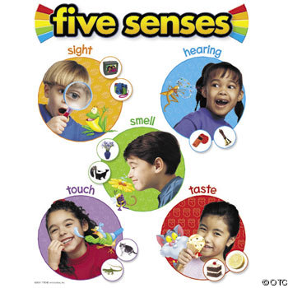
Observation
Information you gather with your senses:
  See
  Hear
  Touch
  Smell
  Taste

Slide 3
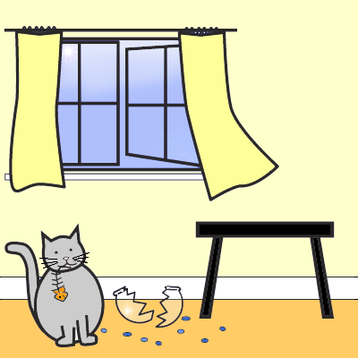
Inference
An untested interpretation based on your observations
What could you infer about what happened in this picture?

Slide 4
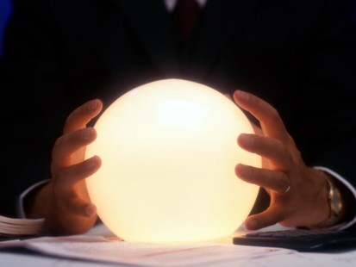
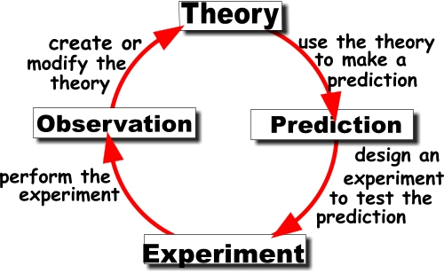
Prediction: a statement of what is likely to happen.
Fortune tellers just guess what will happen
Scientists justify their predictions with what they already know

Slide 5
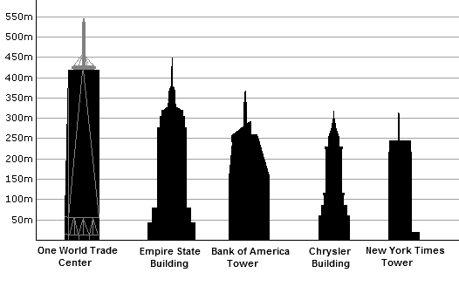
Compare
Identify ways in which things are alike or different

Slide 6
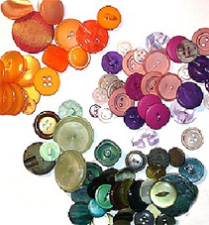
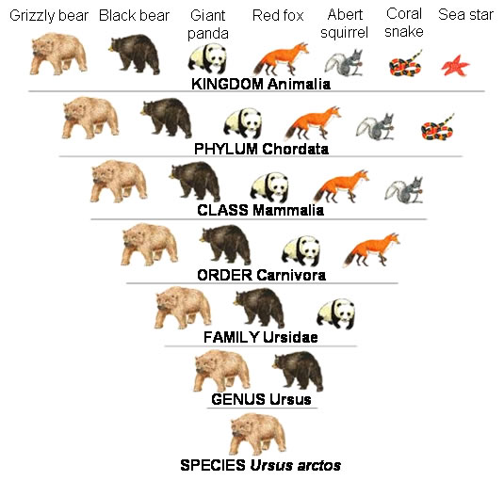
Classify: group or organize things
How we classified when we were little
How scientists classify

Slide 7
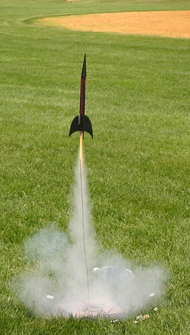
Build a Model
-When they are trying to understand things that are too big, small, fast, slow, dangerous, or expensive to observe in person
-Scientists also use models to try out different ideas when they aren’t sure how to get started
(Mythbusters)

Slide 8
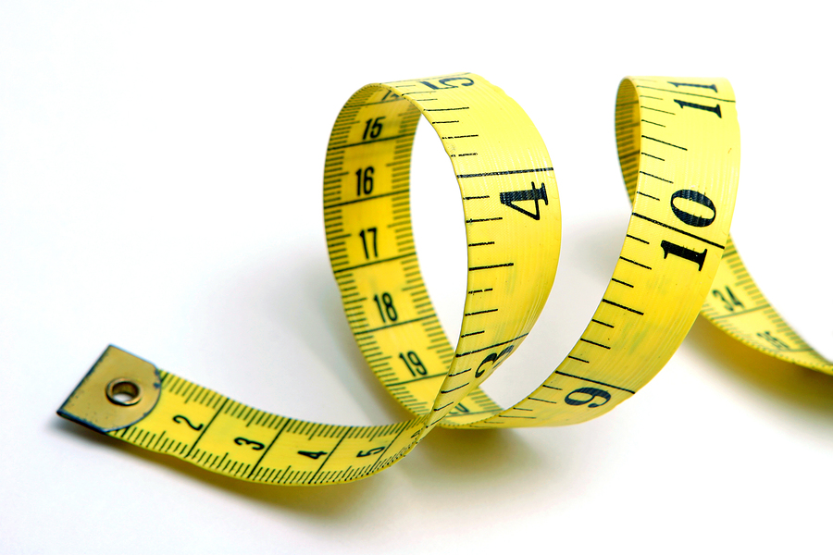
Measure and Estimate
Sometimes scientists make exact measurements using the metric system.
Sometimes it’s not possible to get an exact measurement so they estimate, or make an educated guess.

Slide 9
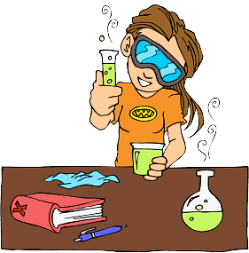
Experiment: A test to find out if a hypothesis is true
A hypothesis is a statement of what you think will happen.
A hypothesis must be testable and cannot be based on an opinion.

Slide 10
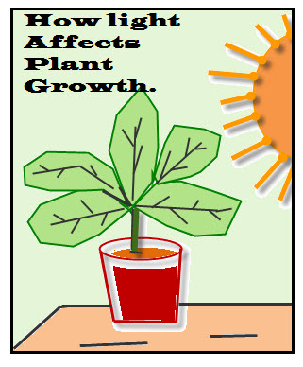
Why is it important to control variables?
If you allow more than one variable to change, you will not know which variable affected the outcome of the experiment.
What variables will need to be controlled in this experiment?

Slide 11
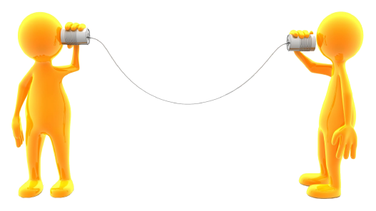
Communicate
Share results and information orally or in writing
We do this by writing in our science notebooks!

