Slide 1
What is the Scientific Method?
And what do fat pigs have to do with it?

Slide 2
scientific method
The general steps scientists follow to test a hypothesis

Slide 3
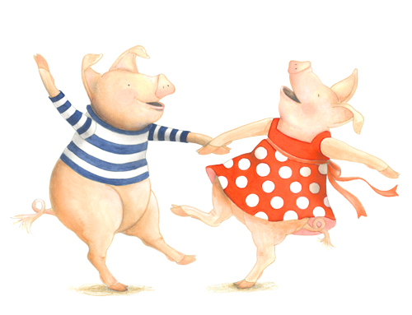
Only Fat Pigs Can Dance
Observe and Ask Questions
Form a Hypothesis
Plan an Investigation
Conduct the Investigation
Draw Conclusions and Communicate Results

Slide 4
Observe and ask questions (Only)
Scientists notice things…
…then they begin to ask questions.

Slide 5
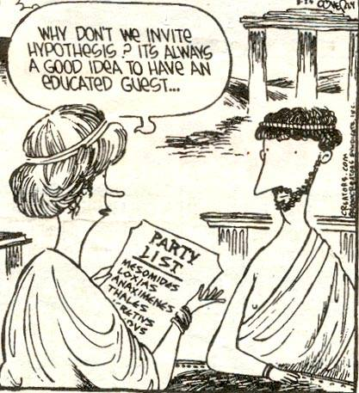
Form a hypothesis (Fat)

Slide 6
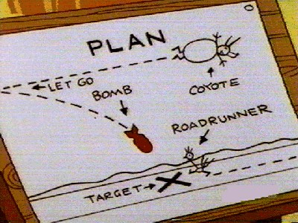
Plan an investigation (Pigs)
Your plan should include doing several trials
This way you will know your results are reliable and repeatable
If you get about the same results on each trial, your measurements are well done

Slide 7
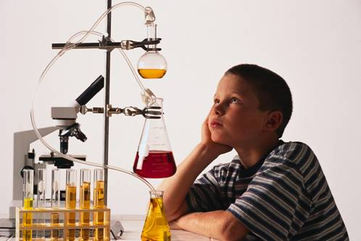
Conduct the investigation (Can)

Slide 8
Draw conclusions… (Dance)
What conclusions will your data help you reach?
… and communicate your results.

Slide 9
Why report your findings?
Scientists share their results so:
1.Others can double-check their work
2. Others can learn from their work and expand on it

Slide 10
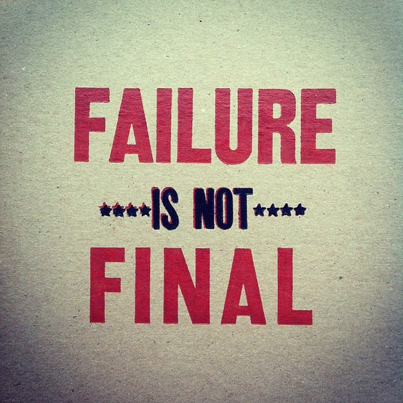
Should you change your results if they do not support your hypothesis?
No
It is ok if your hypothesis is disproven
It is ok if your results are unclear
This may give you a new question to investigate

