Slide 1
What are Producers, Consumers, and Decomposers?

Slide 2
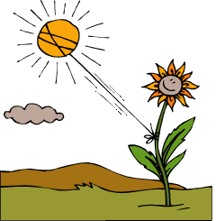
Producers can make their own food!

Slide 3
Consumers must eat plants or other animals.

Slide 4
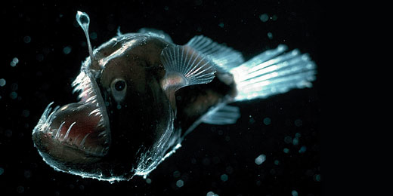
Where do you think they get their energy?

Slide 5
Herbivores
eat only plants (or producers)
Giraffes
Squirrels
Rabbits

Slide 6
Carnivores
Eat only other animals
Bobcats
Spiders
Pelicans

Slide 7
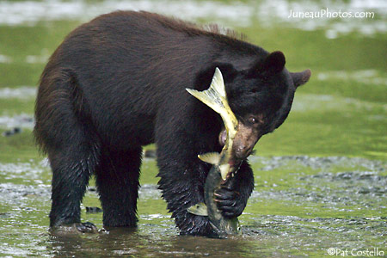
Omnivores
Eats both plants and animals
Hyenas
Opossums
Raccoons

Slide 8
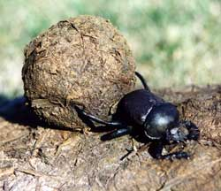
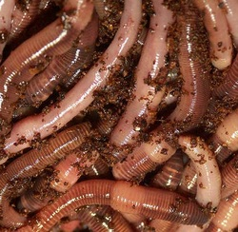
Decomposers feed on the waste or remains of dead plants and animals

