Slide 1
What Are Physical Adaptations?

Slide 2
Basic Needs
Food
Water

Slide 3
Basic Needs
Air
Shelter

Slide 4
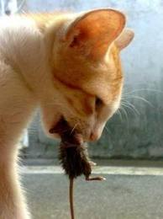
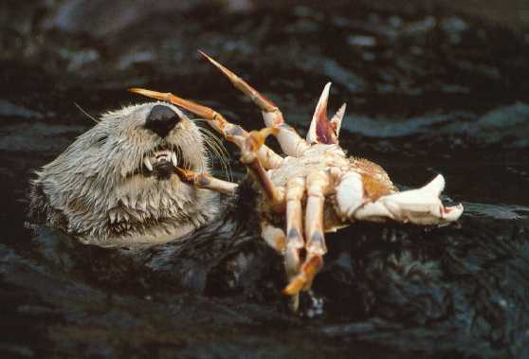
Catching Food

Slide 5
People Farm

Slide 6
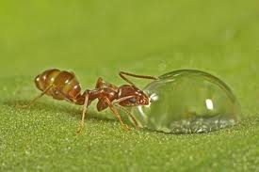
Drinking Water

Slide 7
Breathing

Slide 8
How do aquatic animals breathe?

Slide 9
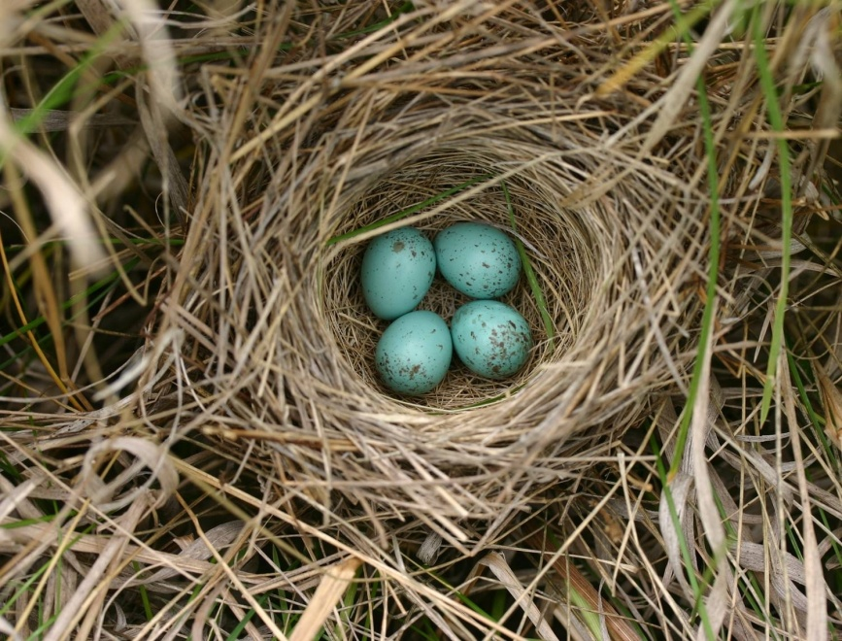
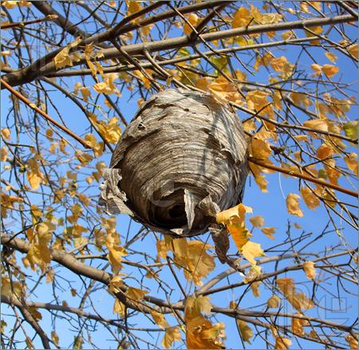
Shelter

Slide 10
adaptation
a body part or behavior that helps a living thing survive

Slide 11
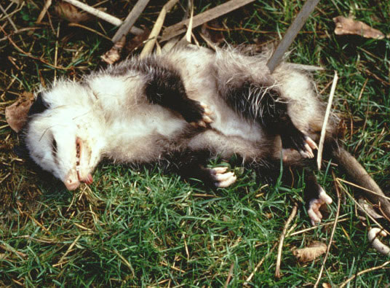
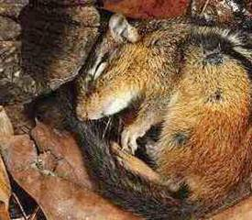
Adaptive behaviors

Slide 12
Different kinds of feet can help birds meet their needs.

Slide 13
Different animals have different uses for their arms

Slide 14
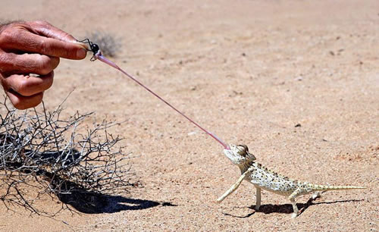
Long tounges

Slide 15
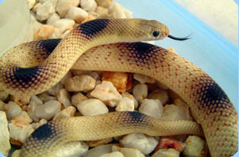
Protective scales

Slide 16
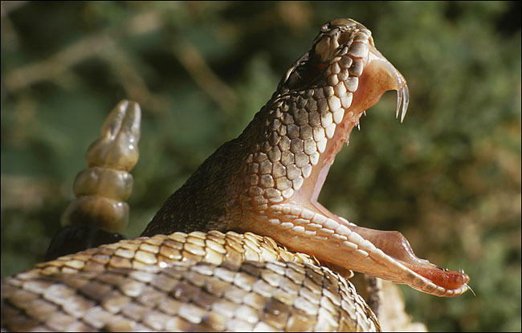
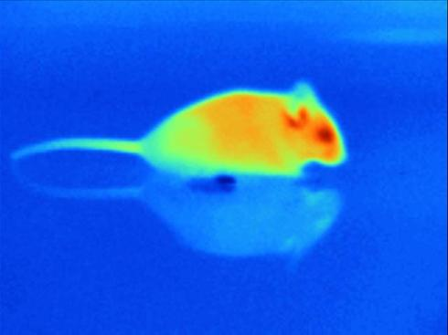
Rattlesnake adaptations

Slide 17
Camo

Slide 18
Camo

Slide 19
Camo

Slide 20
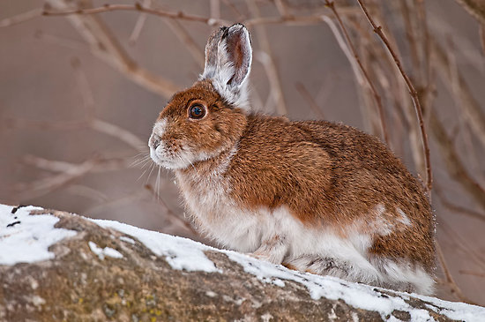
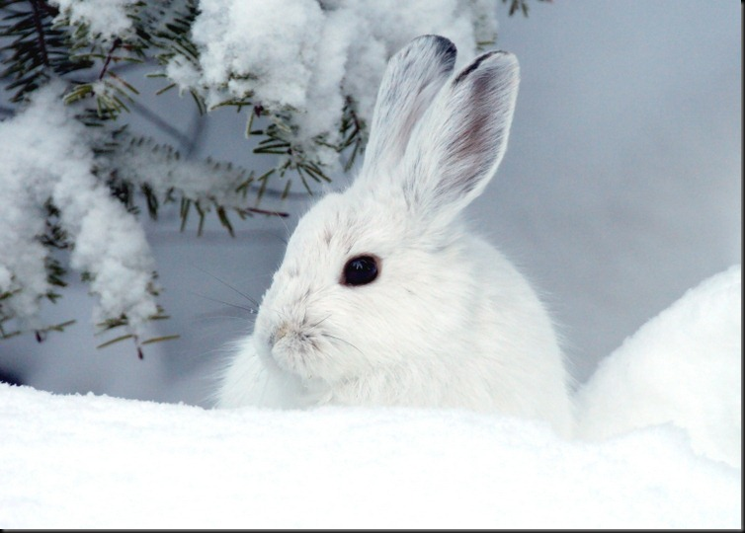
Snowshoe Hare

Slide 21
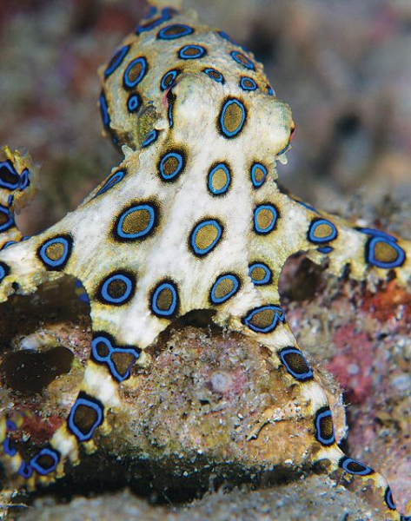
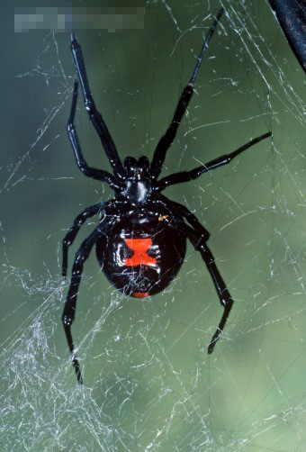
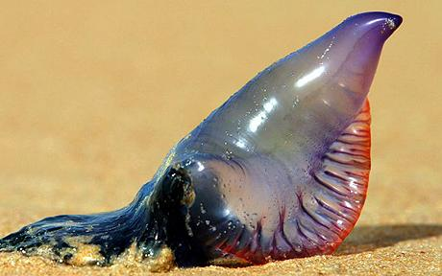
Advertising poison

Slide 22
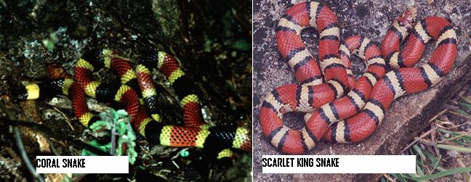
Mimics

Slide 23
Moth larvae or snake?

Slide 24
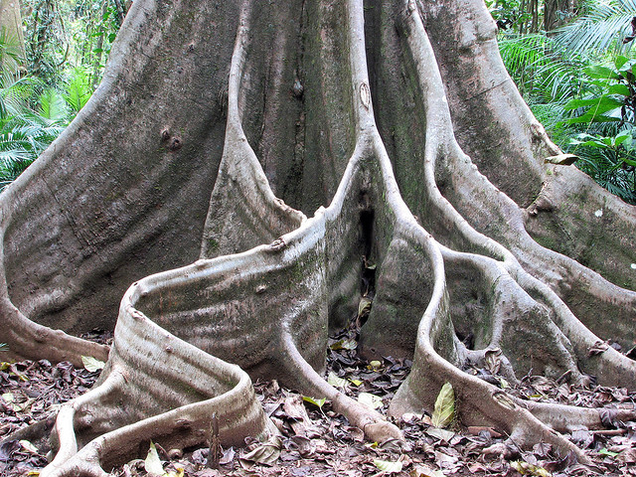
Rainforest plant adaptations

Slide 25
Desert plant adaptations

