Slide 1
How Do Objects Bend Light?

Slide 2
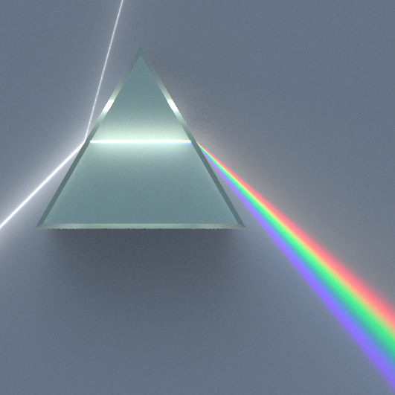
Prisms
As light waves enter, and exit, a prism the light waves change directions.
Each color refracts a slightly different amount.
This separates the white light into its component colors.

Slide 3
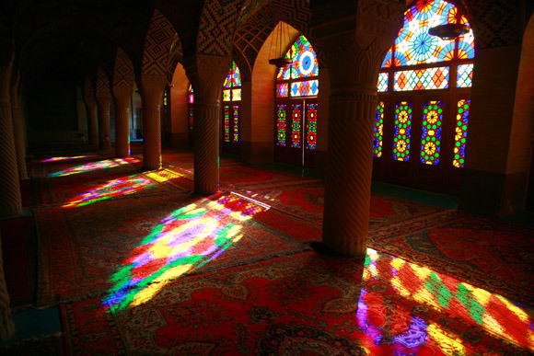
Objects, whether transparent or opaque, appear to be a certain color because of the other colors they absorb.

Slide 4
Rainbows
May form anytime water droplets are in the air.
The droplets act like tiny prisms.
Not all rainy days have rainbows because you have to have sunlight too.

Slide 5
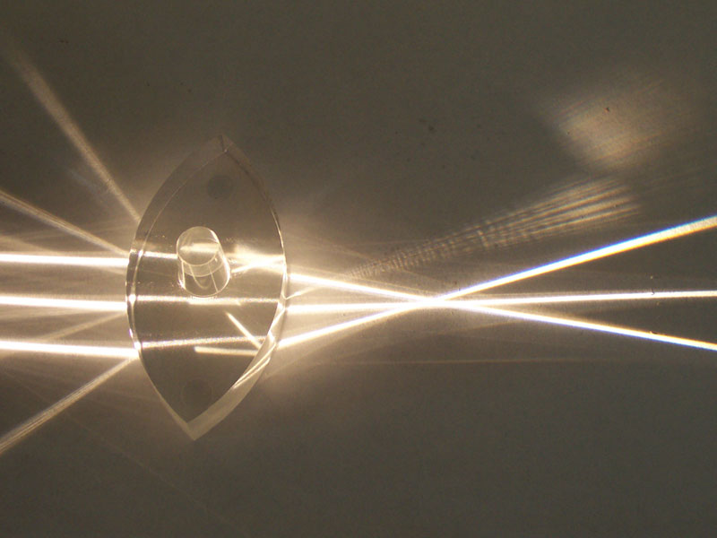
Convex lens
Thicker in the middle
Objects appear to be LARGER
Objects may appear to be upside down

Slide 6
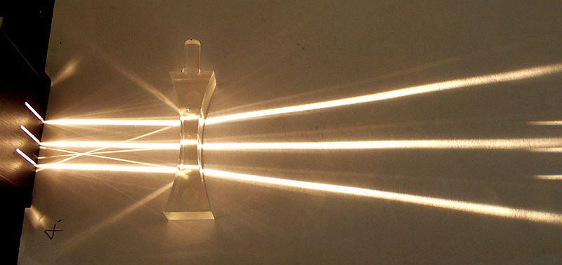
Concave lens
Thicker at the edges
Objects appear to be
smaller
Objects always appear upright

Slide 7
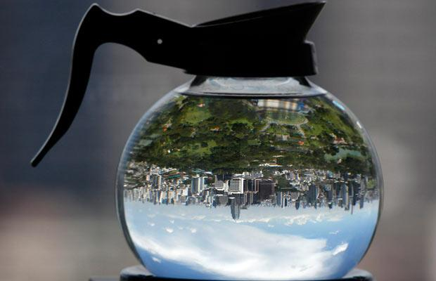
Convex or Concave?

Slide 8
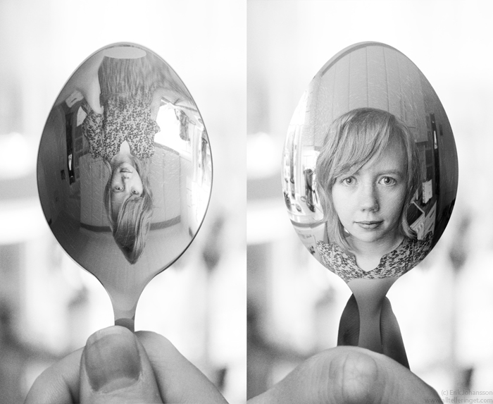
Mirrors can be convex and concave too!

Slide 9
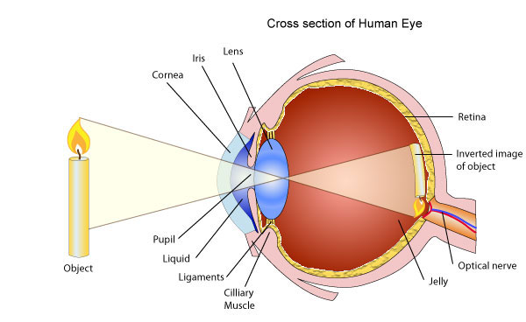
Each of your eyes contains a convex lens.

Slide 10
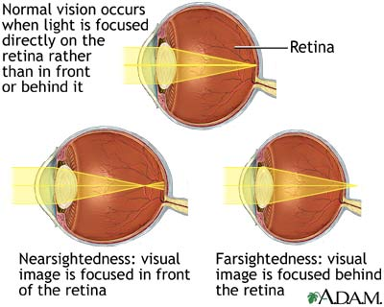
Some people have trouble seeing because of the shape of their eyes.

Slide 11
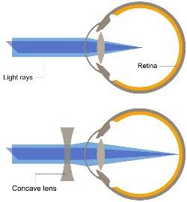
Corrective lenses, glasses or contacts, help get the focal point back on the retina.

