Slide 1
How is Motion Described and Measured?

Slide 2
Where is the roller skate?

Slide 3
There are many ways to describe an objects position or location.

Slide 4
There are many kinds of motion.
Forward and Backward
Up and Down

Slide 5
There are many kinds of motion.
Slow
Fast

Slide 6
There are many kinds of motion.
Straight path
Curved path

Slide 7
How can you tell the car has moved?
Frame of Reference

Slide 8
speed
how the position of an object changes during a certain amount of time

Slide 9
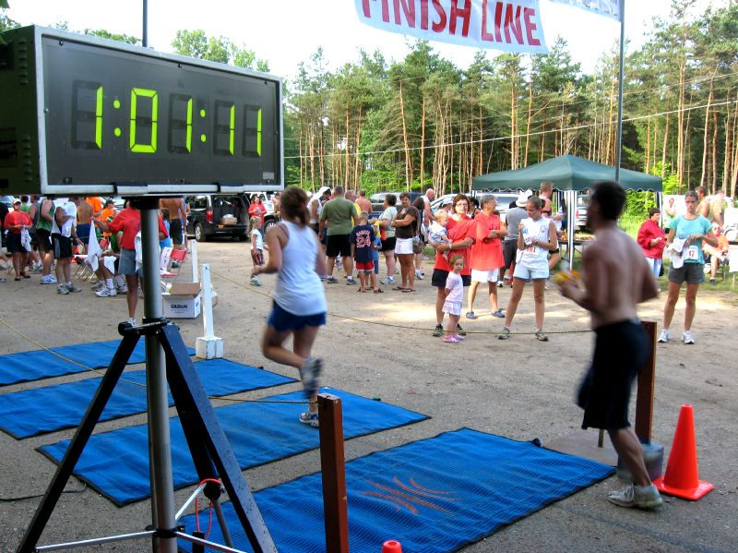
To find an object’s speed, you need to measure two things.
Distance-the change in an object’s position
Time-how long it takes the object to move through the distance.

Slide 10
Speed is the distance traveled divided by the amount of time it took to get there.

Slide 11
You may have seen a radar gun used to measure speed at a baseball game.

Slide 12
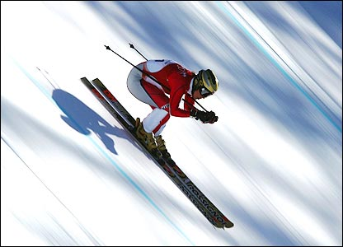
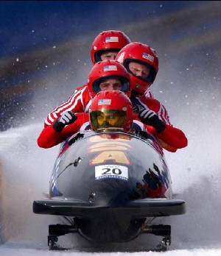
Luge, downhill skiing, and bobsledding are among the fastest sports that do not use motorized vehicles.

Slide 13
What is the difference between instantaneous, peak, and average speeds?

Slide 14
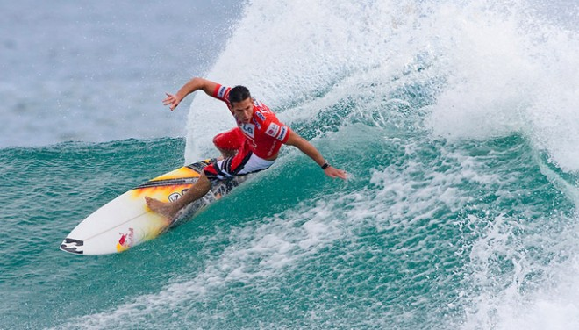
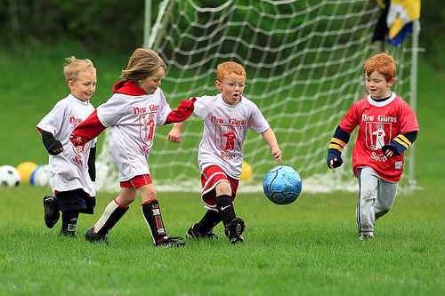
Pictures don’t move, but how do we know the objects in them were moving?

