Slide 1
How Does Energy Flow Through an Ecosystem?

Slide 2
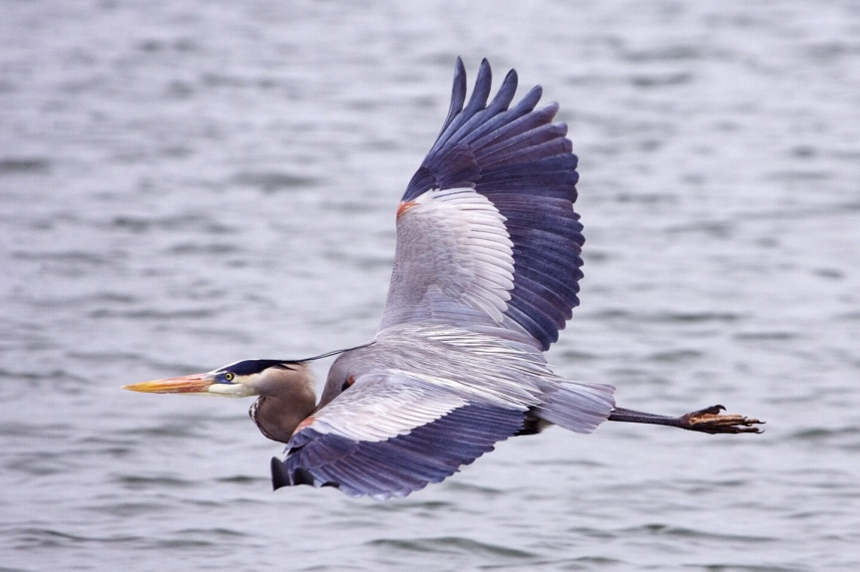
You probably won’t see a heron in the desert…

Slide 3
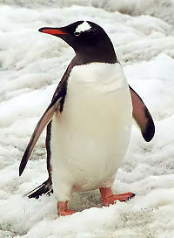
… or a penguin in the swamp.

Slide 4
habitat: An environment that meets the needs of a living thing

Slide 5
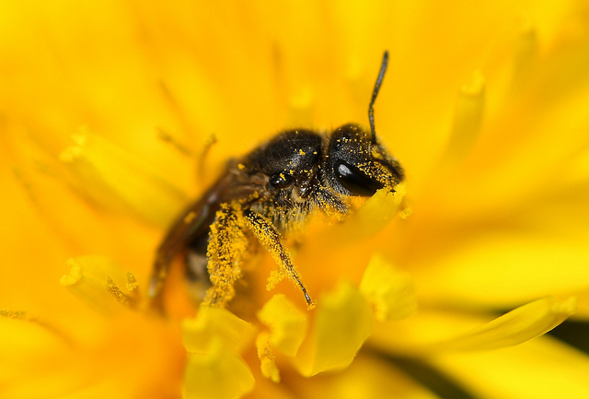
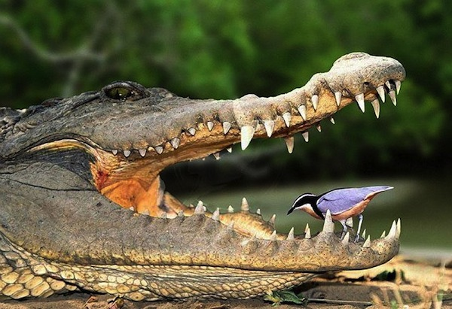
niche: the role of a living thing

Slide 6
food chain: the movement of energy in a sequence

Slide 7
Who is the predator? Who is the prey?

Slide 8
Bobcats affect rabbit populations. Without wolves deer overpopulate.

Slide 9
A food web is a system of food chains that overlap.

Slide 10
Only 10 percent of the food energy passes up to the next level in the pyramid.
First level consumers need many producers to support them.
Second level consumers need many first level consumers to support them.
Only one or two animals are at the top.

Slide 11
If a habitat experiences a drought, the available resources will decrease.

