Slide 1
How Do Scientists Use Graphs?

Slide 2
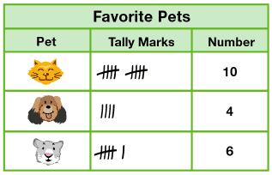
Tables are a good way to collect data in an organized way.

Slide 3
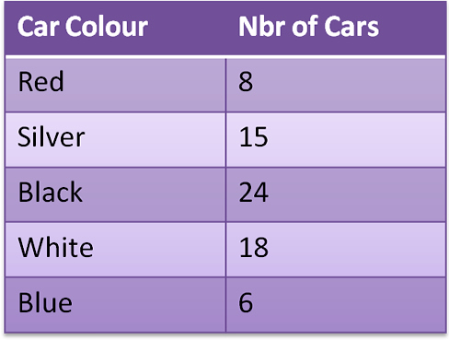
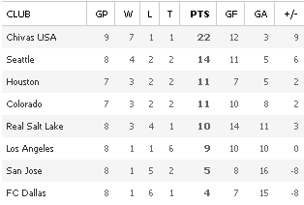
Parts of a Table
Title: what the table is about
Headings: what info is given in each part
MLS Standings

Slide 4
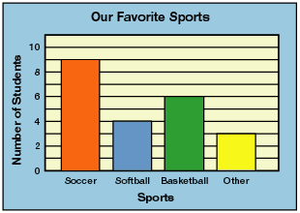
Bar Graphs are good for comparing information about different groups.

Slide 5
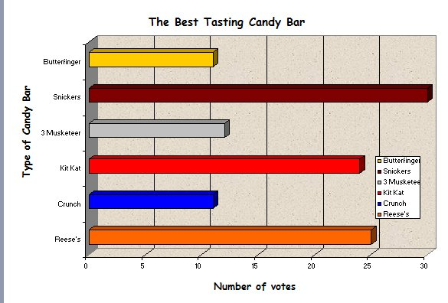
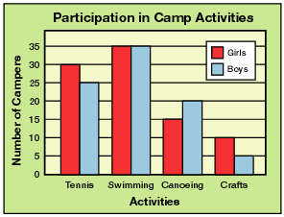
You don’t need to read all the data to interpret a graph!
Horizontal Bars
Double Bar Graph

Slide 6
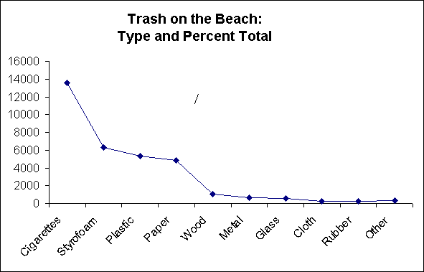
Line graphs are good when you want to show change over time.
What is the unit of time???

Slide 7
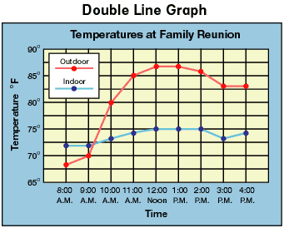
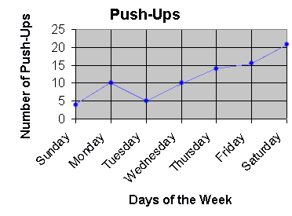
Seconds, minutes, hours, days, weeks, months, years, decades, centuries, or millennia
The unit of time belongs on the x-axis
Double line graphs can compare two sets of data

Slide 8
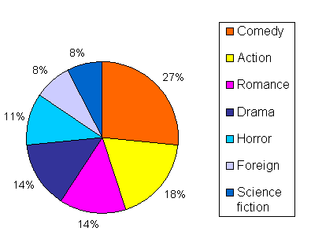
Circle graphs are used to compare parts of something to the whole thing.
Favorite movie genre in Mr. Norris’s class

Slide 9
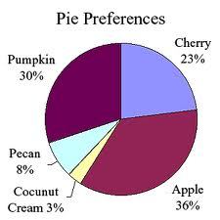
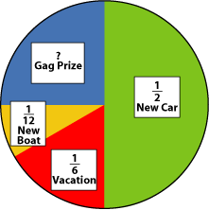
Circle graphs usually show their data as percents of the whole thing
Sometimes called a pie graph
Sometimes fractions are used instead

