Slide 1
What Are Behavioral Adaptations?

Slide 2
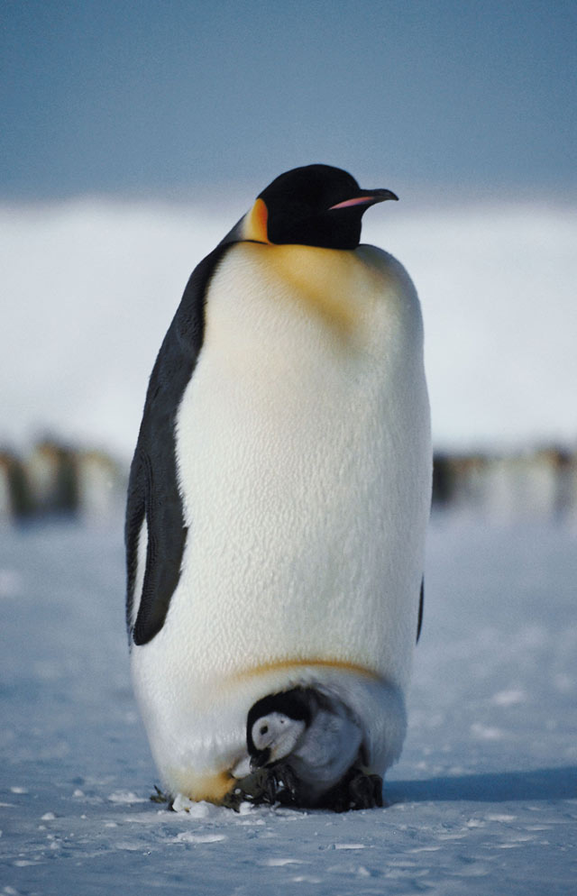
instinct: a behavior an animal is born with

Slide 3
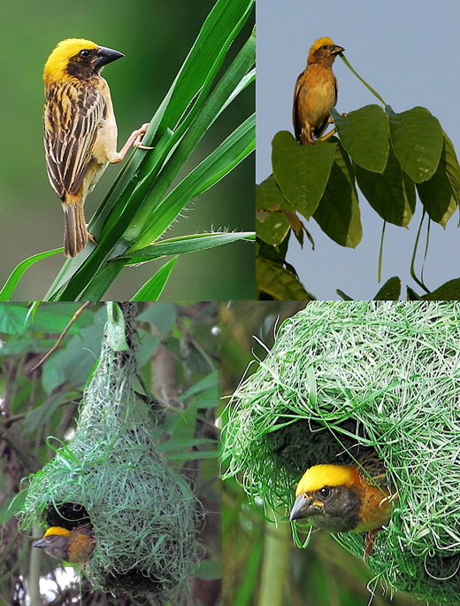
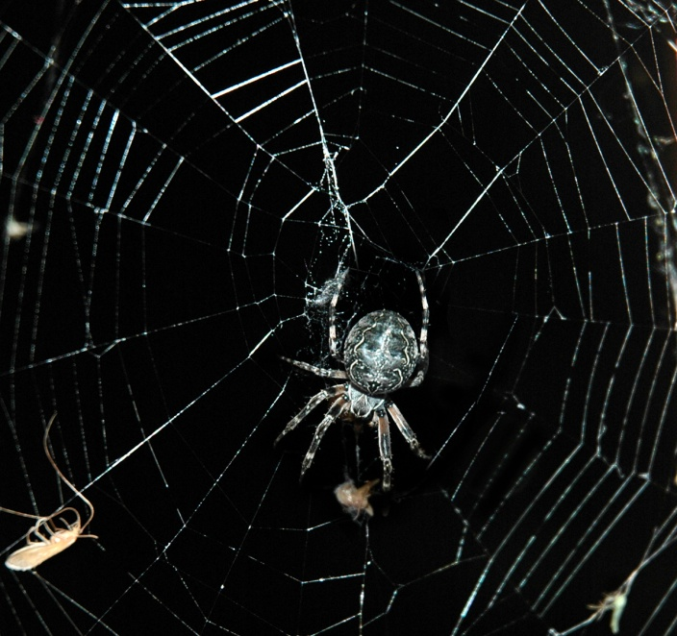
All instincts help an animal survive.

Slide 4
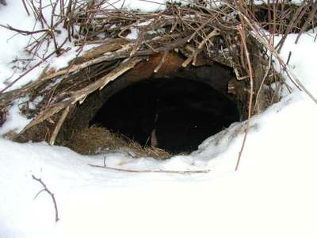
Many animals know by instinct how to get ready for winter.
First, they eat more than normal so they can gain fat.
Then, they find dens or build shelters.

Slide 5
hibernation: an inactive state during which normal body activities slow

Slide 6
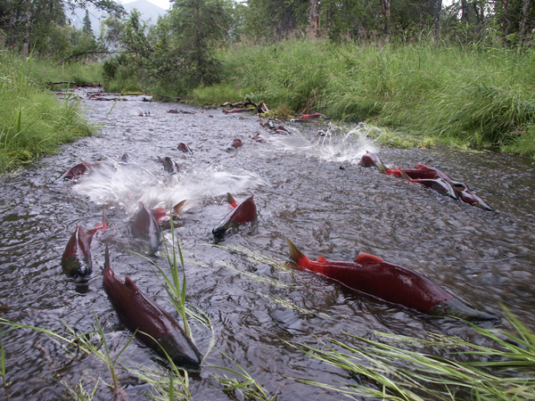
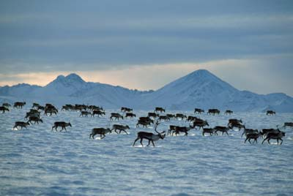
migration: regular movement from one area to another

Slide 7
extinction: the loss of a kind of living thing
Major extinctions in ancient times were natural
Scientists believe there have been between 3 and 5 extinction level events in Earth’s history
None of them were due to human actions

Slide 8
Examples of animals that have gone extinct:

Slide 9
Global warming may cause certain species to go extinct.

Slide 10
Global warming doesn't just affect polar regions.

Slide 11
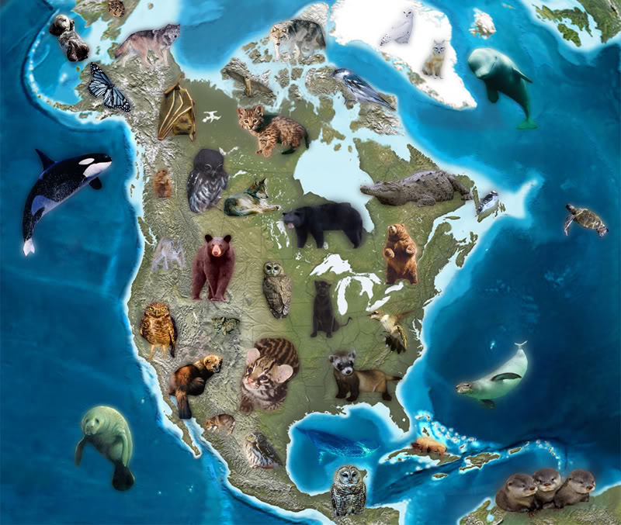
Animals and plants that are close to becoming extinct are called endangered species.

Slide 12
Human actions may contribute to extinction of species as well.
People disturb or destroy habitats when they cut down forests for timber or to make room for buildings.

Slide 13
Human actions may contribute to extinction of species as well.
Over hunting or fishing and area can lead to the extinction of a species.
The people of Mauritius island hunted the dodo bird to extinction.
White settlers almost did the same to the buffalo.

Slide 14
Human actions may contribute to extinction of species as well.
Introducing nonnative species to an area can cause native species to be crowded out

